Slide 1
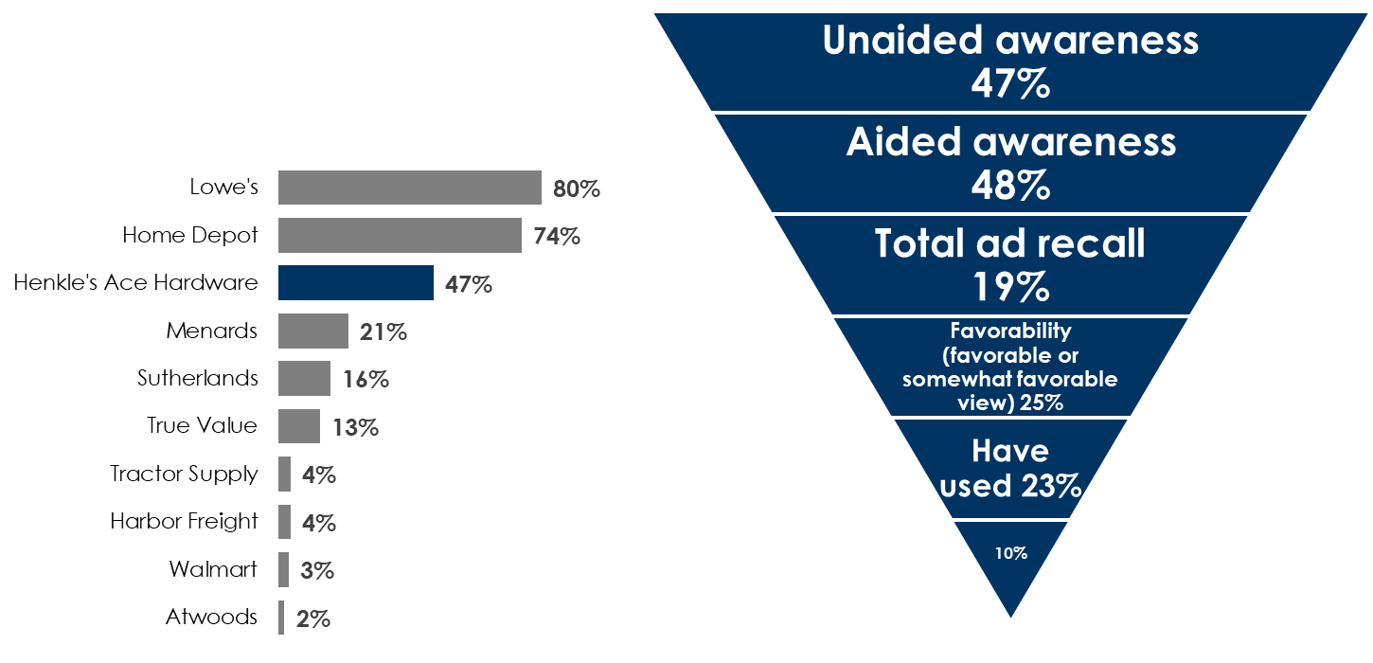
Henkle’s Ace Hardware Of Joplin, Missouri Uses AM/FM Radio To Be Known Before They’re Needed
Henkle’s Ace Hardware places a strong number three in unaided brand awareness as a result of their long-term brand building campaign on AM/FM radio
Q: When you think of hardware/home improvement stores, which ones come to mind?
Thanks to AM/FM radio, Henkle’s Ace Hardware performs strongly across all stages of the customer journey
Purchase intent
INSERT STATION LOGO HERE
Source: Quantilope Study, December 29, 2025-January 7, 2026: 150 persons 18+, Lives in Joplin, MO.

