Slide 1
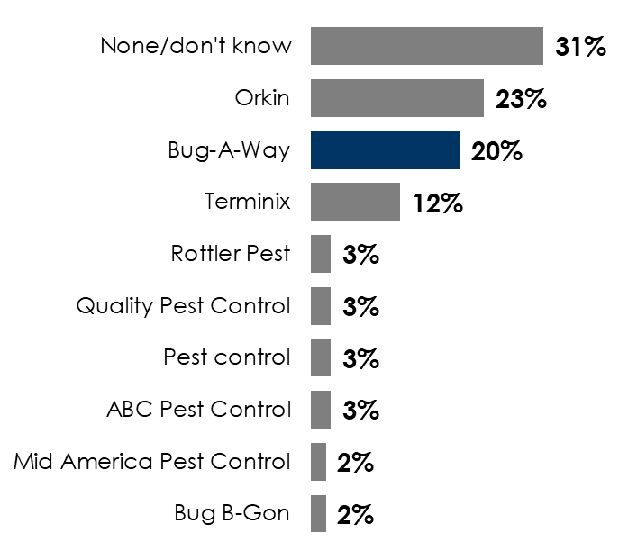
Bug-A-Way Pest Control Of Joplin, Missouri Knows How Advertising Really Works: Be Known Before You’re Needed
Bug-A-Way Pest Control soars from zero to 20% unaided awareness, beating Terminix and placing a close number two to Orkin
Q: When you think of pest control companies, which ones come to mind? (Unaided awareness means respondents are NOT given a list of brands)
The longer people have lived in the area, the greater the awareness of Bug-A-Way Pest Control and a number of other well-known local businesses
 | Aided awareness Q: Including any [category] companies you may have mentioned in the last question, which of the following have you heard of?
Time respondents have lived in the Joplin, MO area | Superior Roofing | Henkle’s Ace Hardware | Roper KIA | Bug-A-Way
10 years or less | 22% | 39% | 59% | 46%
More than 10 years | 43% | 53% | 94% | 61%
INSERT STATION LOGO HERE
Source: Quantilope Study, December 29, 2025-January 7, 2026: 150 persons 18+, Lives in Joplin, MO. 150 persons 18+, Lives in Joplin, MO. 54 lived in Joplin, MO 10 Years or Less. 96 lived in Joplin, MO 10 Years or More.

