Slide 1
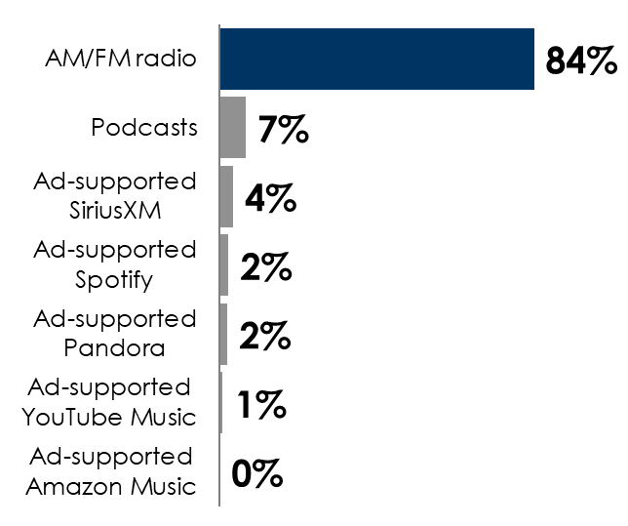
Auto Aftermarket Retailers: New Study Reveals AM/FM Radio Is The Ideal Platform For Reaching Auto Parts Shoppers
Versus TV, AM/FM radio listeners shop more often, spend more, buy from more retailers, and are more engaged with auto aftermarket brands
Time spent in the car powers AM/FM radio listening and the need for auto parts
Edison “Share of Ear” study: AM/FM radio rules ad-supported audio in the car
Share of ad-supported audio time spent in the car among adults 18+
 | Total U.S. | Heavy AM/FM radio listeners | Heavy TV viewers
Average # of shopping trips | 6.0 | 7.1 | 7.5
Average retailers shopped | 2.2 | 2.6 | 2.5
Average times maintenance or service performed on vehicle last year | 2.8 | 3.2 | 2.9
Average spend last year | $626 | $790 | $646
INSERT STATION LOGO HERE
Source: Left: Quantilope September 2025 National Study – 1,000 total respondents 18+. Right: Edison Research, "Share of Ear,” Q4 2024 – Q3 2025. Persons 18+, in the car; SiriusXM: Ad-supported: Spoken Word. Ad-free: Music; Podcasts listened to on streaming platforms are included in 'podcasts;' Percentages may not add up to 100 due to rounding.

