Slide 1
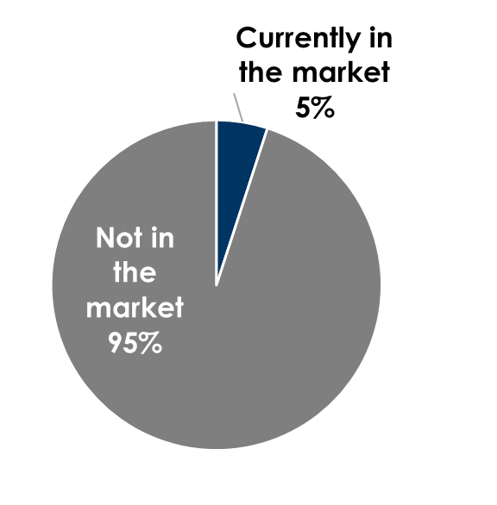
Mind Share Equals Market Share: AM/FM Radio Builds Strong Advertiser Brands In Lake Charles, Louisiana
Thanks to AM/FM radio, Able Plumbing leads in unaided awareness, Burnworth's AC is a top local player and Meads Automotive is the top Lake Charles auto repair brand. Why do retailers have to always advertise? The #1 brand in each category is “on’t know”.
Be known before you’re needed: Only a small number of people are in the market at any point in time
Q: When you think of [CATEGORY], which ones come to mind? (Please type the names of [CATEGORY BRANDS] that come to mind, typing only ONE name in each box provided. If you cannot think of any additional [CATEGORY BRANDS], simply leave the other boxes blank.) (Unaided awareness means respondents are NOT given a list of brands)
Plumbing services |  | HVAC |  | Auto repair brand
None/don't know | 29% | None/don't know | 25% | None/don't know | 23%
Able Plumbing | 14% | ACE | 15% | AutoZone | 11%
Roto-Rooter | 12% | Lowe's | 11% | Meads Automotive | 10%
Lowe's | 8% | Ace Air Cond & Plumbing | 8% | Navarre | 9%
Ace | 5% | Trouth | 7% | Firestone | 6%
Home Depot | 5% | Burnworth's AC | 6% | Jiffy Lube | 5%
Stine | 5% | Cole Air Heat & Cooling | 5% | O’Reilly Auto Parts | 5%
Ace Plumbing | 4% | Home Depot | 5% | Mavis Tires & Breaks | 4%
Allstar Plumbing | 3% | Stine | 4% | Ashford's Automotive | 3%
Pistol's Plumbing | 3% | Air Conduit | 3% | Bolton | 3%
INSERT STATION LOGO HERE
Source: Left: Quantilope Study, August 22-October 24, 2025: 100 persons 18+, Lives in Lake Charles, LA. Right: Ehrenberg Bass Institute of Marketing Science

