Slide 1
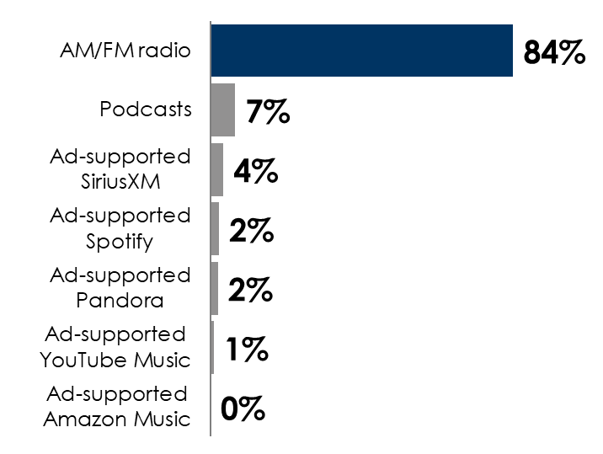
Q3 2025 Edison “Share Of Ear”: AM/FM Radio Dominates Ad-Supported Audio
AM/FM radio leads ad-supported audio across major demos
AM/FM radio rules ad-supported audio in the car
Share of ad-supported audio time spent in the car among persons 18+
 | Share of ad-supported audio time spent
 | P18+ | P18-34 | P18-49 | P25-54 | P35-64 | P50+
AM/FM radio | 64% | 45% | 54% | 60% | 68% | 75%
Podcasts | 20% | 33% | 28% | 25% | 19% | 12%
Ad-supported Spotify | 6% | 11% | 8% | 5% | 4% | 3%
Ad-supported Pandora | 5% | 6% | 6% | 6% | 5% | 5%
Ad-supported SiriusXM | 3% | 1% | 2% | 2% | 3% | 4%
Ad-supported YouTube Music | 1% | 3% | 2% | 2% | 1% | 1%
Ad-supported Amazon Music | 1% | 1% | 0.5% | 0.2% | 1% | 1%
Source: Left: Edison Research, "Share of Ear,” Q4 2024 – Q3 2025; SiriusXM: Ad-Supported: Spoken Word. Ad-Free: Music; Podcasts listened to on streaming platforms are included in 'podcasts;' Percentages may not add up to 100 due to rounding. Right: Edison Research, "Share of Ear,” Q4 2024 – Q3 2025. Persons 18+, in the car; SiriusXM: Ad-supported: Spoken Word. Ad-free: Music; Podcasts listened to on streaming platforms are included in 'podcasts;' Percentages may not add up to 100 due to rounding.
INSERT STATION LOGO HERE

