Slide 1
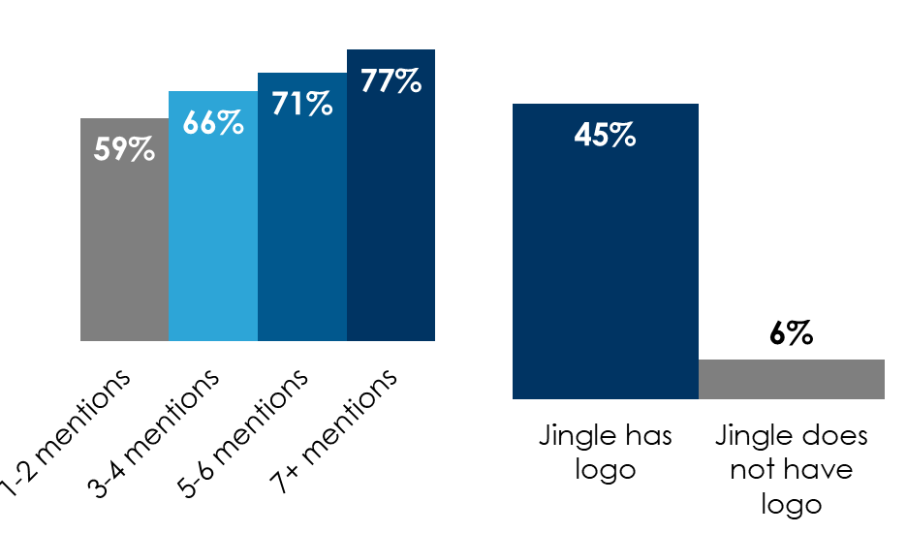
Audio Creative Best Practice: Brand Early And Often
In audio, more brand mentions = higher ad recall
Brand recall
Create a jingle that says the name of the brand
% of respondents who identified the correct brand associated with the logo (unaided)
For TV, as audio brand mentions increase, brand recall explodes and soars
TV ads with 5 audio brand mentions have double the brand recall (+50%)
7.5X
INSERT STATION LOGO HERE
Source: Left: Nielsen Podcast Brand Effect Study 2020; Chart figures reflect average Top 2 Box Exposed percentage. [RECALL] Which brands do you recall from your experience with the audio content? Middle: Veritonic 2022 Audio Logo Index; Right: DVJ Insights: Conveying Your Brand In Advertising: Show… Or Tell

