Slide 1
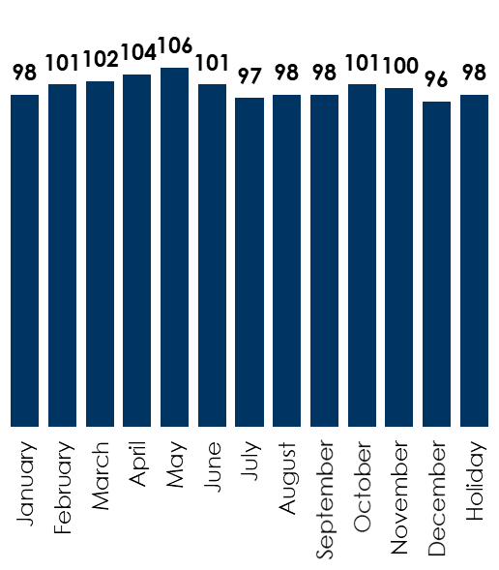
How to buy AM/FM radio throughout the year
Advertiser on AM/FM radio throughout the year to take advantage of consistent listening
Total AQH persons 12+ from PPM markets (Mon-Sun 6A-mid); Indexed to average January-holiday
Optimal daypart allocation
Use AM/FM radio for your holiday sales events
77%
of all Americans are reached by AM/FM radio every holiday week
According to Nielsen, the ideal daypart allocation based on how Americans listen to AM/FM radio is:
22% Mon-Fri, 6AM-10AM
26% Mon-Fri, 10AM-3PM
20% Mon-Fri, 3PM-7PM
7% Mon-Fri, 7PM-mid
20% Sat-Sun, 6AM-mid
5% Mon-Sun, mid-6AM
Source: Left: Nielsen, average 2022-2024 (2024 through Dec.), Persons 12+ AQH in millions from PPM markets, Mon-Sun 6A-mid; Middle: Nielsen Audio, Persons Using Radio, Fall 2024 Nationwide, share of total listening hours by time period, persons 25-54; Right: Nielsen Audio, 48 PPM Markets, Weekly Cume Rating, M-Su 12m-12m, November 2023 – October 2024, Holidays reflect corresponding PPM survey weeks in 2023-2024
INSERT STATION LOGO HERE

