Slide 1
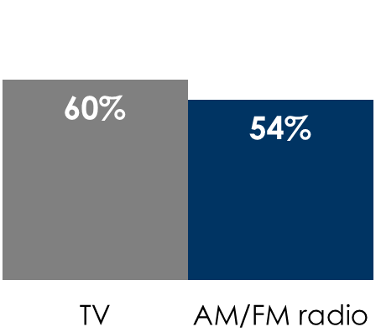
Case study: AM/FM radio works for legal firm Bradshaw & Bryant in St. Cloud, MN (market ranked 184)
Bradshaw & Bryant leads the attorney category in top of mind awareness, outperforming the next firm by more than 2 to 1
While the majority of their ad spend is on AM/FM radio, ad recall for Bradshaw & Bryant is equally associated with AM/FM radio and TV
AM/FM radio works
Awareness of Bradshaw & Bryant is
+19%
stronger among AM/FM radio listeners
% total respondents, top 5 Q: “When you think of personal injury lawyers and criminal defense attorneys, which ones come to mind? (Unaided awareness means respondents are NOT given a list of brands)
None/don't know | 35%
Bradshaw & Bryant | 28%
Meshbesher & Spence | 12%
Schwebel, Goetz & Sieben | 5%
Heller & Thyen Law | 3%
% of respondents who recall advertising for Bradshaw & Bryant
Q: “Please select where you have seen or heard advertising for each of the personal injury lawyers and criminal defense attorneys below.”
INSERT STATION LOGO HERE
Source: Quantilope Study, May 15-21, 2025: 120 persons 18+, Lives in St. Cloud, MN.

