Slide 1
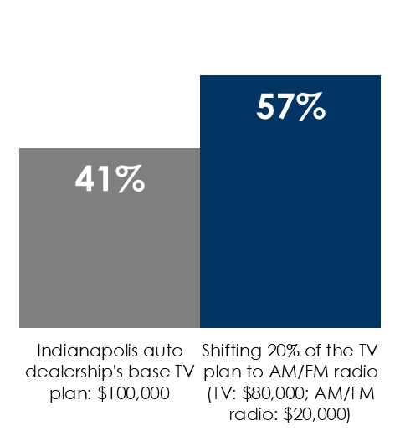
Auto Dealers: Focus Less On The Competition And More On Auto Intenders Who Cannot Name One Car Retailer
Shifting 20% of the linear TV budget to AM/FM radio reaches +40% more auto intenders
36% of Americans cannot name an auto dealer
21% of auto intenders are unable to indicate the name of an auto retailer
Be known before you are needed
Nielsen: 25-54 auto intenders reached, November 2024, Indianapolis
21%
of recent auto buyers were already aware of the dealership they purchased from
(% of Dallas-Ft. Worth prior year purchasers who bought/leased from a dealership)
+40%
Source: Left: Scarborough USA+ 2024 Release 2 & 2023 Release 2 Total (Jun 2022 – Oct 2024) Adults 18+; Middle: MARU/Matchbox Dallas DMA Study – March-April 2023, 600 total respondents, 190 prior year purchasers who bought/leased from a dealership; Q: Were you aware of the dealership you bought/leased from before the purchase? (% of prior year purchasers who bought/leased from a dealership); Right: Local Nielsen Media Impact Fusion, Indianapolis area auto dealer, A54-54 auto intenders (Plan to Buy /Lease Vehicle/Next Year), November 2024, Indianapolis (Total Universe)
INSERT STATION LOGO HERE

