Slide 1
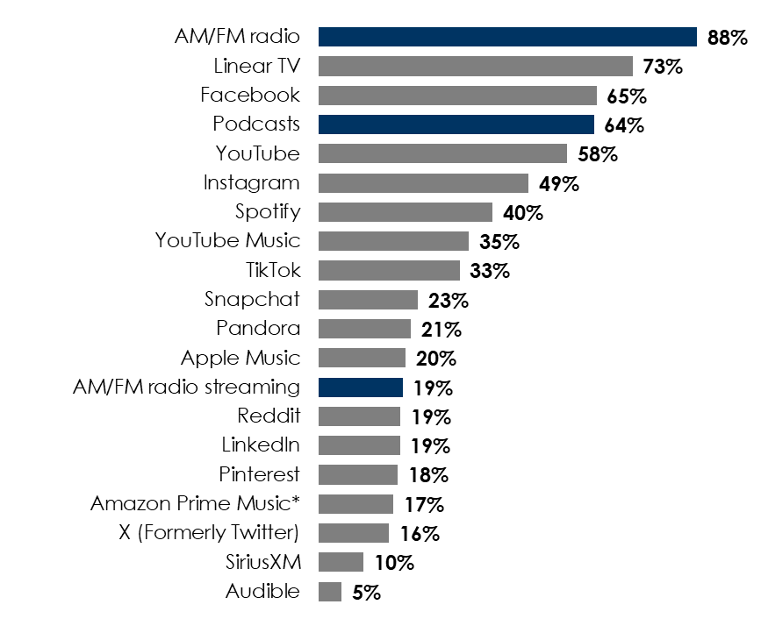
How AM/FM Radio Elevates the Media Plan
AM/FM radio has the greatest monthly reach across all media
Monthly reach/usage among persons 25-54
AM/FM radio adds significant incremental reach to social media platforms
Monthly incremental reach/usage added when AM/FM radio is added among persons 25-54
+25%
+55%
+106%
INSERT STATION LOGO HERE
Source: Left: AM/FM radio: Nielsen Comparable Metrics Q3 2024; TV: Nielsen Total Media Fusion 12/1/24-12/28/24 (Total Universe 18+); Podcasts: Edison Research, The Infinite Dial Study 2025; All other channels: 2025 Winter MRI-Simmons USA; Right: 2025 Winter MRI-Simmons USA; *Amazon Prime Music includes Amazon Music Unlimited

