Slide 1
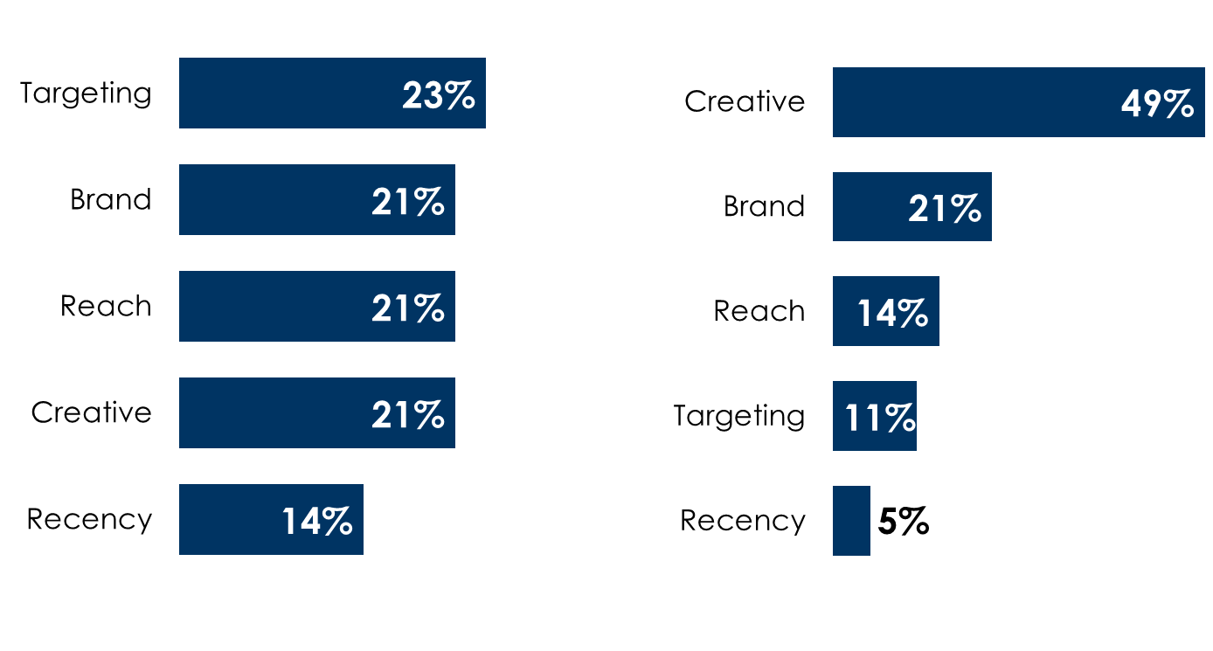
Perceptions vs. reality: Advertisers underappreciate creative and overestimate the sales effect of targeting, reach, and recency
Perception
February 2025 Advertiser Perceptions study of 301 marketers and media agencies: Average % of perception of campaign contribution toward driving sales
Reality
NCSolutions study of nearly 450 advertising campaigns and elements that contribute to sales lift on all major media platforms
INSERT STATION LOGO HERE
Source: Left: Advertiser Perceptions, February 2025, 301 marketer and media agencies surveyed, Base: Total Respondents; Q: Please assign a percentage to each of the following campaign attributes based on how much you feel each contributes to driving sales; Right: NCSolutions, Five Keys to Advertising Effectiveness, 2023: NCSolutions analyzed nearly 450 CPG campaigns across both digital and TV, using NCS Sales Effect to measure results. Each campaign was evaluated according to the 18 features that represent the five keys of advertising; Analytic Partners, 20 Insights for 20 Years​

