Slide 1
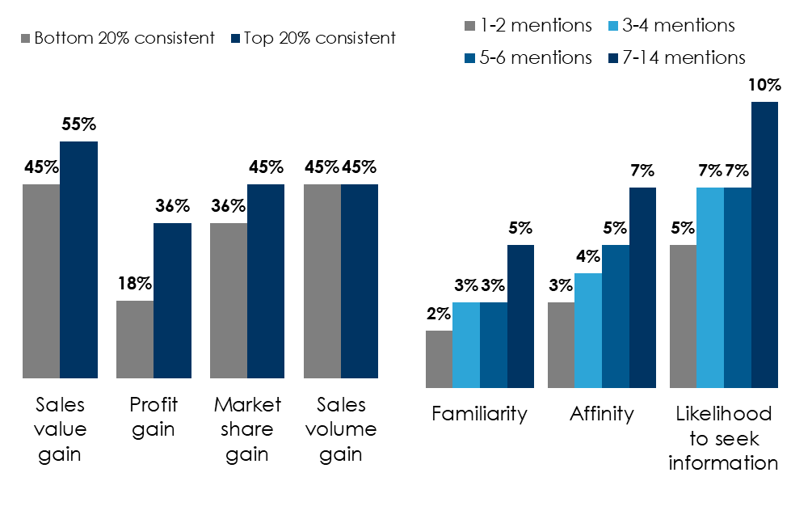
3 Creative Best Practices From Marketing Effectiveness Leaders And Advertising Measurement Firms
Creative consistency drives business outcomes
Brand early and often
Emotion is your best selling tool
Percentage reporting very large business effects
More brand mentions drive lift
% reporting very large effects on intermediate business metrics
 | Rational campaigns | Emotional campaigns
Sales | 46% | 55%
Share | 28% | 31%
Pricing | 2% | 5%
Loyalty | 5% | 11%
New customers | 27% | 27%
INSERT STATION LOGO HERE
Source: Left: Source: System1 & IPA; The Magic Of Compound Creativity How Consistency Leads To Creative Quality, Stronger Brands, And Greater Profits; 56 brands across 44 categories analyzed between 2018 and 2024 for 13 different Creative Consistency Features, comparing the most to the least consistent brands. 4164 TV ads with £3.3bil media spend. Matched with latest IPA awards cases. Middle: Nielsen Podcast Brand Effect Study 2020; Chart figures reflect average Top 2 Box Exposed percentage. [FAMILIARITY]. How familiar are you with the following retailers?[AFFINITY] How do you feel about the following retailers? [INFO SEEK INTENT] How likely are you to look up information on each of the following retailers in the near future? Right: The Long and the Short of It: Balancing Short and Long-Term Marketing Strategies; Les Binet, Head of Effectiveness, adam&eve DDB & Peter Field, Marketing Consultant​

