Slide 1
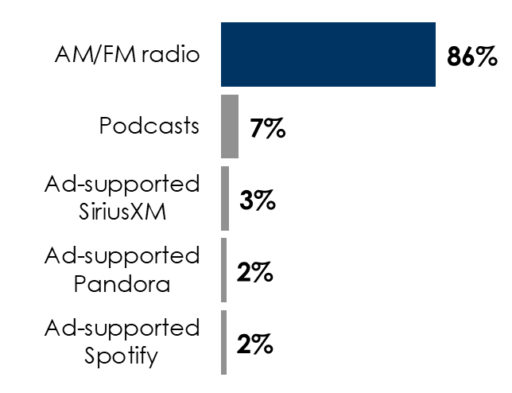
Auto Aftermarket Retailers: New Study Reveals AM/FM Radio Is The Ideal Platform For Reaching Auto Parts Shoppers
Versus TV, AM/FM radio listeners shop more often, spend more, buy from more retailers, and are more engaged with auto aftermarket brands
Time spent in the car powers AM/FM radio listening and the need for auto parts
Edison “Share of Ear” study: AM/FM radio rules ad-supported audio in the car
Share of ad-supported audio time spent in the car among adults 18+
 | Total U.S. | Heavy AM/FM radio listeners | Heavy TV viewers
Average # of shopping trips | 6.5 | 9.0 | 7.4
Average retailers shopped | 2.4 | 3.1 | 2.5
Average times maintenance or service performed on vehicle last year | 3 | 3.6 | 3
Average spend last year | $797 | $977 | $789
INSERT STATION LOGO HERE
Source: Left: MARU/Matchbox August 2024 National Study – 1,138 total respondents 18+. Right: Edison Research, “Share of Ear,” Q2 2024. Persons 18+; SiriusXM: Ad-Supported: Spoken Word. Ad-Free: Music Percentages may not add up to 100 due to rounding

