Slide 1
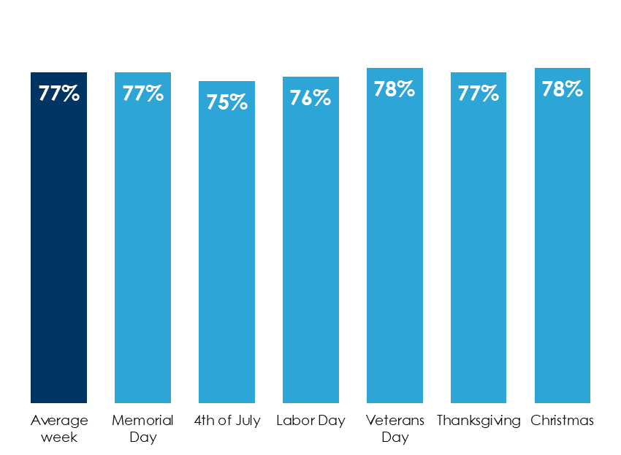
AM/FM Radio Delivers Results For Retailers In Every Holiday Season
AM/FM radio reaches consumers during holiday weeks
AM/FM radio drives retail ROI: $16 of retail sales per $1 spent in AM/FM radio
% of adults 18+ reached by AM/FM radio, Monday through Sunday 6AM-midnight
Grocery | $23
Auto aftermarket | $21
Department store | $17
Mass merchandiser | $16
Home improvement retailer A | $15
Gasoline retailer | $12
Retail | $11
Home improvement retailer B | $9
Average | $16
INSERT STATION LOGO HERE
Source: Left: Source: Nielsen Audio, 48 PPM Markets, Weekly Cume Rating, M-Su 6a-12m, November 2023 – October 2024; Holidays reflect corresponding PPM survey weeks in 2023-2024; Right: Nielsen 2014-2019

