Slide 1
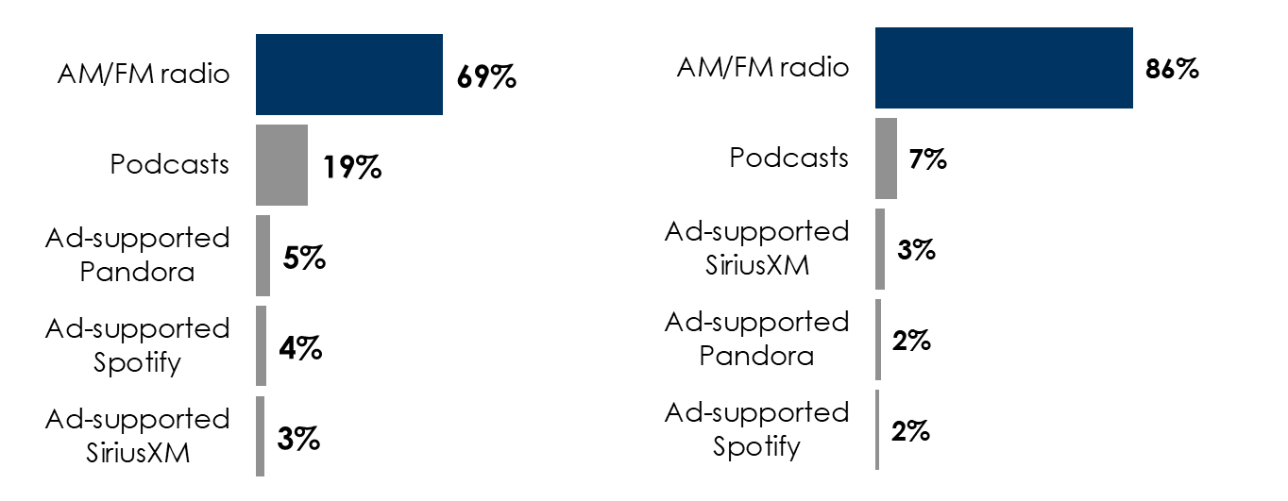
Edison’s Q2 2024 “Share Of Ear” Reveals The Enduring Strength Of AM/FM Radio
AM/FM radio leads ad-supported audio shares: AM/FM radio has a dominant 69% share of ad-supported audio
AM/FM radio rules ad-supported audio in the car: In the car, AM/FM radio has a stunning 86% share of ad-supported audio
Share of ad-supported audio time spent among persons 18+
Share of ad-supported audio time spent in the car among persons 18+
INSERT STATION LOGO HERE
Source: Left: Edison Research, "Share of Ear,” Q3 2023 – Q2 2024. Persons 18+; SiriusXM: Ad-Supported: Spoken Word. Ad-Free: Music; Podcasts listened to on streaming platforms are included in 'podcasts.’ Right: Edison Research, "Share of Ear,” Q3 2023 – Q2 2024. Persons 18+, in the car; SiriusXM: Ad-supported: Spoken Word. Ad-free: Music; Podcasts listened to on streaming platforms are included in 'podcasts;' Percentages may not add up to 100 due to rounding.

