Slide 1
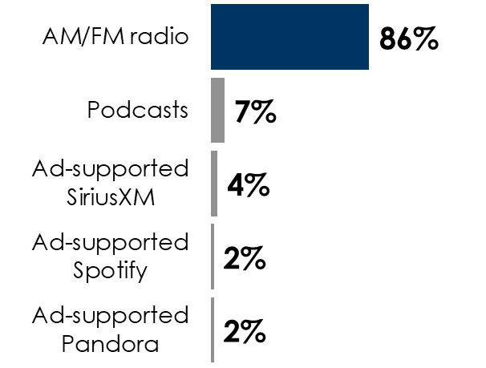
Advertisers Would Pay 16% Extra For In-Car Visual Displays That Sync To AM/FM Radio Ads, According To Advertiser Perceptions
Associating a visual with AM/FM radio ads takes advantage of AM/FM radio’s massive share of in-car listening
Share of ad-supported audio time spent in the car among adults 18+
The more you listen and drive, the more you notice the in-car AM/FM radio display
70% of heavy AM/FM radio listeners say they regularly/occasionally pay attention to the in-car AM/FM radio display screen when they listen
64% of “mega milers,” those who clock 150 or more miles in the car weekly, say they regularly/occasionally pay attention
INSERT STATION LOGO HERE
Source: Left: Edison Research, "Share of Ear,” Q2 2023 – Q1 2024. Persons 18+, in the car; SiriusXM: Ad-supported: Spoken Word. Ad-free: Music; Podcasts listened to on streaming platforms are included in 'podcasts;' Percentages may not add up to 100 due to rounding; Right: Cumulus Media | Westwood One-commissioned MARU/Matchbox study of 1,065 adults in the U.S., conducted between June 3 and June 10, 2021.

