Slide 1
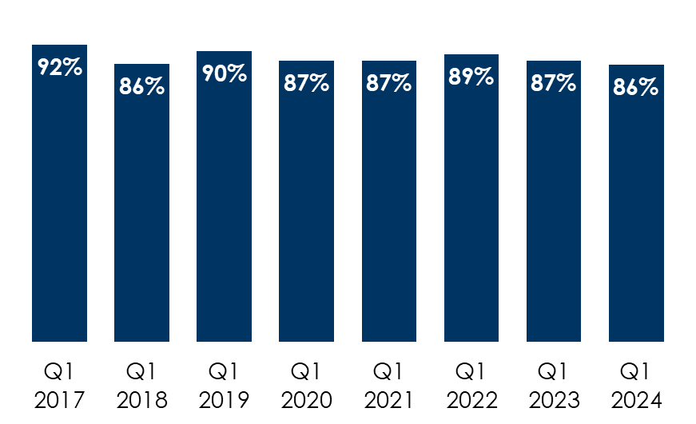
Back To The Office: Average American Commuting Returns While AM/FM Radio Continues To Dominate In-Car Listening
AM/FM radio’s in-car share
trend is remarkably consistent
Back to the office
AM/FM radio’s share of ad-supported audio in the car among persons 18+
85%
of pre-COVID commuters are now working outside the home
INSERT STATION LOGO HERE
Source: Left: MARU/Matchbox April 2024, study of 1617 adults 18+; Right: Edison Research, "Share of Ear,” Persons 18+ in the car, Q1 2017-Q1 2024.

