Slide 1
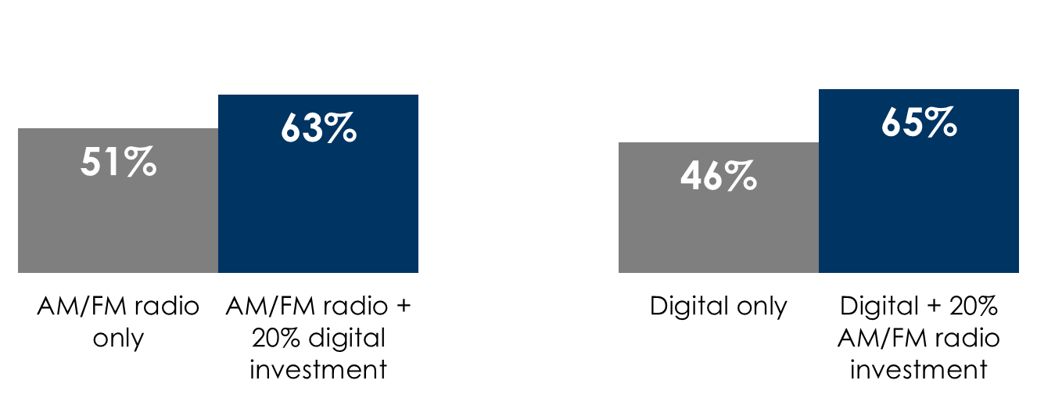
Digital makes the AM/FM radio plan better and vice versa
Adding online video and social to an AM/FM radio campaign delivers incremental reach
Adding AM/FM radio to digital-only campaigns generates large reach growth
Adults 25-54 monthly reach
Adults 25-54, monthly reach
+24%
+41%
INSERT STATION LOGO HERE
Source: Left: Nielsen Commspoint US 2023; AM/FM radio CPPs: A25-54 - $9,200, A18-24 - $10,900, A25-34 - $8,300, A35-44 - $7,100, A45-54 – $9,400, A55-64 - $11,100, A65+ - $14,000;n Social: Commspoint US 2023 default CPPs – Spend evenly split between Facebook, YouTube, Twitter, Instagram; Right: Source: Nielsen Media Impact November 2023, adults 25-54: Network Radio reach based on all network affiliated radio stations at an average CPP of $5000. Digital reach based on desktop, mobile, and tablet at an average CPM of $10; $3M Digital, $600K Radio

