Slide 1
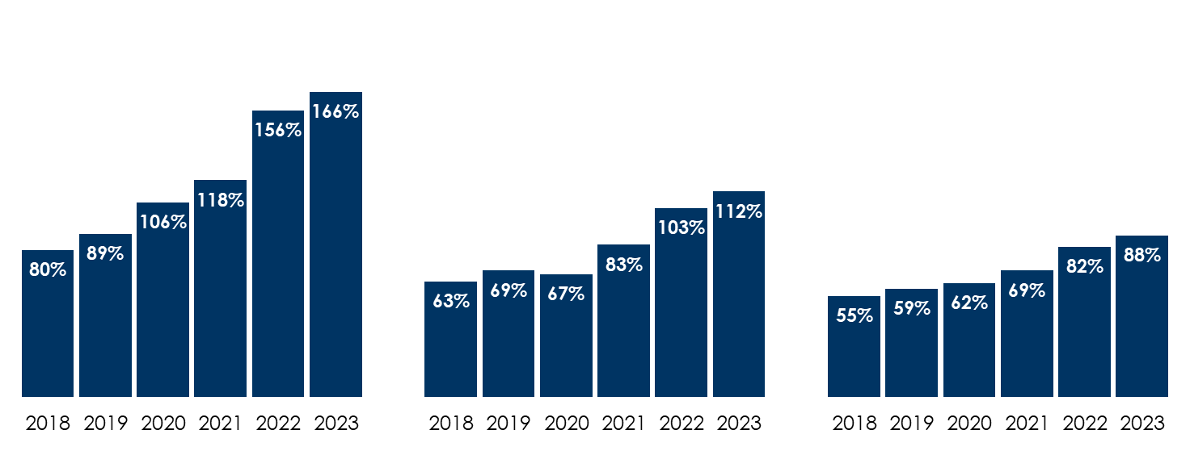
Nielsen: Among persons 18-34 and 18-49, AM/FM radio has surpassed TV in average audience; Among persons 25-54, AM/FM radio is closing in on TV
Nielsen Comparable Metrics: Average audience of AM/FM radio as a % of live + time-shifted TV
Persons 18-34
Persons 18-49
Persons 25-54
INSERT STATION LOGO HERE
Source: Persons 18-49: Nielsen Comparable Metrics, Q2 2018, Q2 2019, Q2 2020, Q3 2021, Q3 2022, Q3 2023. Persons 18-34: Q2 2018, Q2 2019, Q3 2020, Q3 2021, Q3 2022, Q3 2023. Persons 25-54: Q2 2018, Q2 2019, Q3 2020, Q3 2021, Q3 2022, Q3 2023. Average audience determined by multiplying weekly reach of users by weekly time spent among users of each medium.

