Slide 1
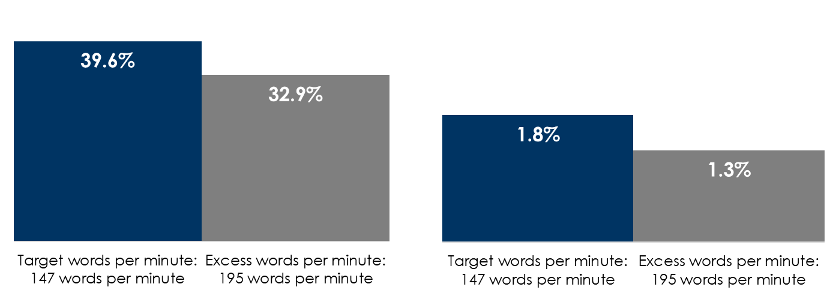
Less Is More: Reduce Audio Ad Copy Word Count And Improve Effectiveness
Over 10,000 audio campaigns including 615 national brands across 22 advertiser categories
Target words per minute = 147 words, the average WPM rate for audio ads with no Terms & Conditions
Excessive words per minute = 195, the average for audio ads with long Terms & Conditions
Average creative standout score
Average web response rate
+20%
+38%
INSERT STATION LOGO HERE
Source: Audiotrack / Big Audio Datamine / Colourtext 2022; https://colourtext.com/music-and-audio/what-is-the-perfect-word-rate-for-an-audio-ad/

