Slide 1
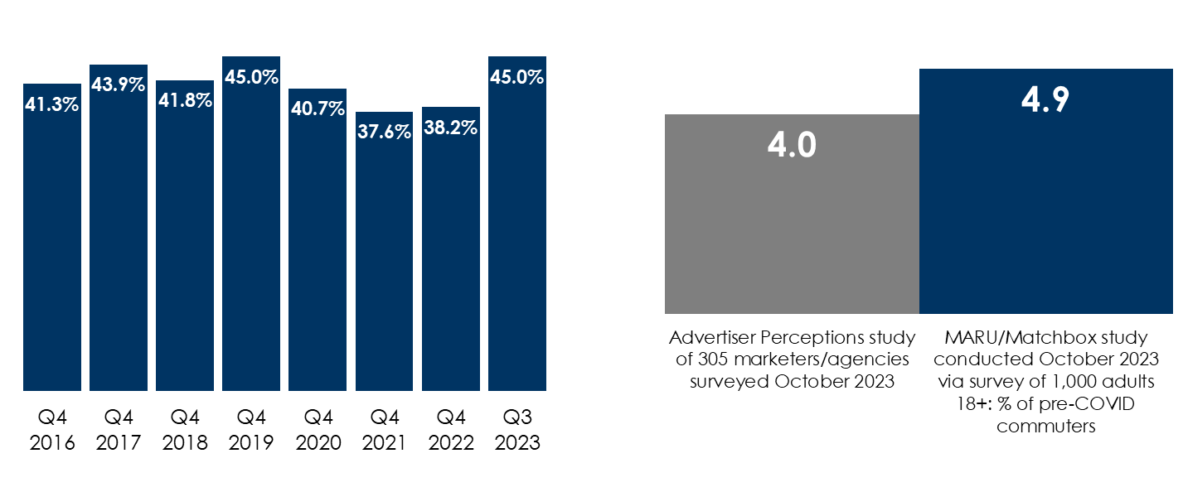
Back To Work: Average Americans Are Back To Commuting And Are Exposed More Frequently To Out-Of-Home Advertising And AM/FM Radio Ads
AM/FM radio's share of total time spent in the car/truck is at its highest point in 8 years
Persons 13+, % of total AM/FM radio time spent listening in a car/truck
Typical Americans are more likely to be exposed to AM/FM radio commercials since they commute more days
Q: How many days per week are you working in the office? Among those commuting to the office
INSERT STATION LOGO HERE
Source: Left: Edison Research, “Share of Ear,” Q3 2023, persons 13+; Right: Advertiser Perceptions survey of 305 marketers/agencies, October 2nd – 9th, 2023; Base: Among those commuting to the office (82% of marketers/agencies); MARU/Matchbox October 2023, study of 1000 adults 18+

