Slide 1
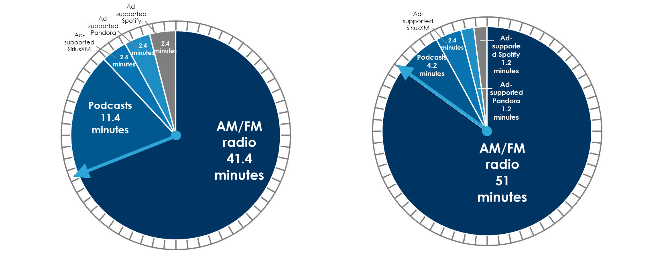
AM/FM Radio Represents The Vast Majority Of Time On The “U.S. Ad-Supported Audio Clock”
Ad-supported audio
Number of minutes spent with ad-supported audio platforms in a typical hour
In the car: Ad-supported audio
Number of minutes spent with ad-supported audio platforms in the car in a typical hour
INSERT STATION LOGO HERE
Source: Left: Edison Research “Share of Ear” Q2 2023, persons 18+ ad-supported audio share: AM/FM radio 69%, Podcasts 19%, Spotify ad-Supported 4%, Pandora ad-supported 4%, SiriusXM ad-supported 4%; Right: Edison Research “Share of Ear” Q2 2023, persons 18+ ad-supported audio share in the car: AM/FM radio 85%, Podcasts 7%, Spotify ad-Supported 2%, Pandora ad-supported 2%, SiriusXM ad-supported 4%

