Slide 1
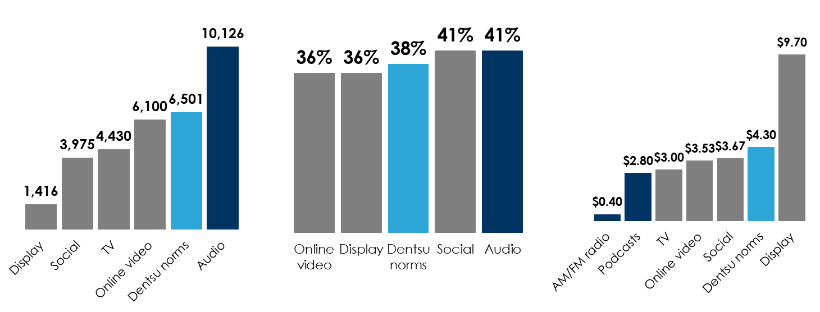
Dentsu Carat: Audio attention and brand equity outperform visual media; Audio is the most cost efficient​
Audio has +56% greater attentiveness scores versus Dentsu Carat norms
Average attentive seconds per (000) - APM
Audio generates +8% greater brand recall versus Dentsu Carat norms
Brand recall
AM/FM radio and podcasts are more cost efficient than TV and Dentsu Carat norms
Attention CPM (aCPM)
INSERT STATION LOGO HERE
Source: Dentsu Carat/Lumen Attention Economy Study 2023: Combined audio attention result highlights, TV not available for brand recall

