Slide 1
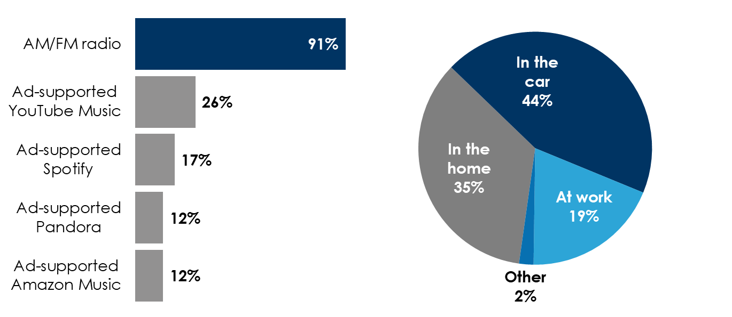
AM/FM radio is the #1 mass reach audio medium with 65% of listening taking place out of home
AM/FM radio has the highest ad-supported monthly reach
Most AM/FM radio listening takes place out of the home
Monthly % reach of ad-supported audio among adults 18+
% of all out of home listening by location, full week
65% of AM/FM radio listening takes place out of home
INSERT STATION LOGO HERE
Source: Left: Nielsen RADAR Q4 2022, Nielsen Scarborough USA+ Rel 2 2022, current 6 months; Right: Nielsen National Regional Database, Adults 18+ - Q4 2022 Audio Diary markets only - Q4 2022

