Slide 1
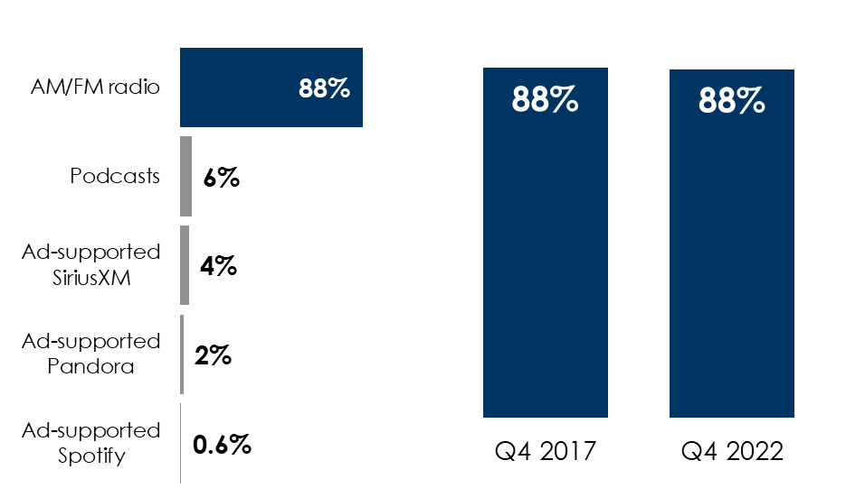
82 Million Reasons To Keep AM Radio In Vehicles And AM/FM Radio Is Still The Queen Of The Road
AM/FM radio dominates listening in the car with an 88% share of ad-supported audio
AM/FM radio’s near-90 share of in-car ad-supported audio has been steady as a rock for the last six years
AM radio is valued in the car
Share of ad-supported audio time spent in the car among persons 18+
AM/FM radio’s share of ad-supported audio in the car among persons 18+
82,346,800 Americans listen to AM radio monthly
One out of three American AM/FM radio listeners are reached monthly by AM radio
57% of the AM radio audience listens to News/Talk stations
INSERT STATION LOGO HERE
Source: Left: Nielsen Fall 2022; Middle: Edison Research, "Share of Ear,” Q1-Q4 2022. Persons 18+, in the car; SiriusXM: Ad-supported: Spoken Word. Ad-free: Music; Percentages may not add up to 100 due to rounding; Right: Edison Research, "Share of Ear,” Persons 18+ in the car, Q4 2017-Q4 2022.

