Slide 1
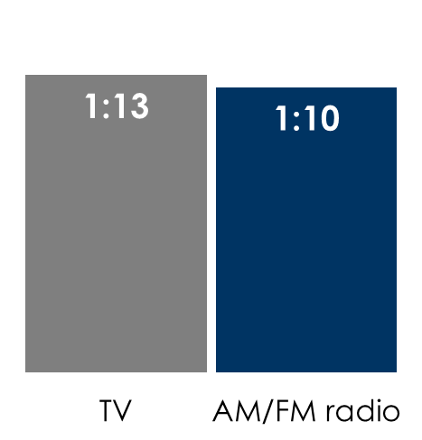
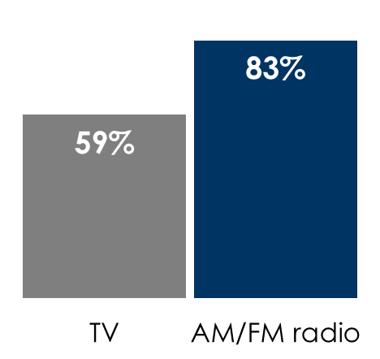
AM/FM Radio Ratings Overtake TV Among Persons 18-49 For The First Time In Media History
AM/FM radio outreaches TV by +41%
TV’s daily time spent advantage over AM/FM radio is shrinking
Persons 18-49 average audience of AM/FM radio as a % of live + time-shifted TV
Persons 18-49 weekly reach
% of U.S. population; Q3 2022
Persons 18-49 daily time spent
Hours:minutes among U.S. population; Q3 2022
In Q3 2022, AM/FM radio's average audience was +3%
larger than TV’s
INSERT STATION LOGO HERE
Source: Left/middle: Nielsen Total Audience Report, Persons 18-49 weekly reach % of users of live + time-shifted TV among U.S. population. Daily time spent is hours:minutes among U.S. population. Right: Nielsen Total Audience Report, Q2 2018, Q2 2019, Q2 2020, Q3 2021, Q3 2022. Persons 18-49. Average audience determined by multiplying weekly reach of users by weekly time spent among users of each medium

